Slide 1





Pitch Deck
Attenue
vishalkochar@gmail.com
saketkumarsingh@kgpian.iitkgp.ac.in
IIT Kharagpur

Slide 2



AGENDA
1
Introduction
6
Revenue Analysis
2
Problem Statement
7
Use of funds
3
Our Innovative Solutions
8
App Development
4
Size of Market
9
Website Development
5
Direct & Indirect Competitor

Slide 3

INTRODUCTION
In an era where automation is revolutionizing various aspects of daily life, traditional methods of attendance tracking are becoming outdated. Attenue, our innovative attendance management system, addresses this by leveraging cutting-edge computer vision technology. Designed to streamline the process of taking attendance in educational institutions, this system uses facial recognition to identify students in real-time, eliminating the need for manual record-keeping. By combining machine learning algorithms and a reliable database, Attenue ensures a high level of accuracy and efficiency.
The system's scalability and adaptability make it an ideal solution for schools, colleges, and universities, saving time and minimizing errors. This project not only focuses on the technical side but also ensures smooth integration with existing systems, data privacy, and user-friendly interfaces. As we progress, our aim is to provide a robust, secure, and easy-to-use platform that improves classroom management and optimizes administrative tasks.

Slide 4

Time-Consuming and Error-Prone Attendance Methods
Traditional manual attendance processes are slow, inefficient, and prone to human errors, leading to inaccuracies in attendance records.
Inefficient Use of Classroom Time
iValuable classroom time is wasted in marking attendance manually, reducing the time available for teaching and learning activities.
PROBLEM STATEMENT
Lack of Real-Time Monitoring and Data Analysis
Existing systems lack real-time data collection and analysis, making it difficult to track attendance trends and identify issues promptly, such as absenteeism or late arrivals.

Slide 5




OUR INNOVATIVE SOLUTIONS
Automated Attendance via Facial Recognition
Real-Time Data Processing and Accuracy
Seamless Integration and Scalability
Our system leverages advanced computer vision and facial recognition technology to automatically identify and record attendance, eliminating the need for manual tracking.
Using machine learning algorithms, the system ensures high accuracy and processes data in real-time, providing immediate updates on student attendance while minimizing errors.
The solution is designed to integrate easily with existing systems and databases, while being able to meet the needs of educational institutions. It can be deployed across classrooms or campuses.

Slide 6
SIZE OF MARKET
Serviceable Obtainable Market: 30 Million
Understanding the market size is important for us. The global education technology (EdTech) market is expected to grow significantly, projected to reach $404 billion by 2025, with increasing adoption of digital solutions in education institutions.With over 1.5 billion students globally, the demand for automated attendance and classroom management tools is rising, particularly in schools, universities, and corporate training.In India alone, with more than 300 million students, the market for automated attendance systems is expanding rapidly as institutions seek to improve operational efficiency and adopt smart technology.
Serviceable Addressable Market: 1.5Million (India Only)
Total Addressable Market: 20 Billion

Slide 7
COMPETITOR ANALYSIS
WHY ARE WE BETTER?
KENT Cam Attendance Technology: Uses facial recognition to capture attendance by matching images with a pre-registered database. Strengths: Proven technology with a user-friendly interface. Weaknesses: Primarily hardware-dependent, higher upfront cost, limited customizability for different institutions. Focus Market: Corporate and large organizations.
Deep North Technology: Provides computer vision solutions including attendance tracking and student engagement monitoring. Strengths: Broad computer vision capabilities across multiple sectors. Weaknesses: Focuses more on retail and broader use cases, less tailored to educational institutions specifically. Focus Market: Retail, healthcare, and education.
Truein Technology: A cloud-based facial recognition attendance system designed for educational institutions, manufacturing, and corporate sectors. It uses AI-driven face recognition algorithms that can work in varying light conditions and does not require any additional hardware. Strengths: Low initial investment since it can work with existing devices (phones, tablets), highly customizable, and tailored specifically for educational institutions. Weaknesses: Limited offline functionality; dependent on cloud access for real-time attendance tracking.
Tailored for Educational Institutions: Our system is specifically designed for schools, colleges, and universities, ensuring a seamless fit into the unique needs of classroom attendance management.
Scalability and Customization: Unlike competitors that are rigid or hardware-dependent, our solution offers flexibility. It’s scalable for both small classrooms and large campuses, with options for customization based on institution size and requirements.
Cost-Effective and Efficient: We focus on minimizing hardware dependency, utilizing existing infrastructure (webcams, security cameras) to reduce costs, while delivering real-time, accurate attendance with minimal upfront investment.
Real-Time Data and Insights: In addition to tracking attendance, our system provides real-time data analytics to help institutions monitor student attendance trends, address absenteeism, and optimize resource management.
Focus on Privacy and Security: Our solution complies with strict data privacy laws and offers encrypted storage of sensitive facial data, ensuring a higher level of security compared to competitors.

Slide 8
REVENUE ANALYSIS
YEAR
Projected Revenue
Revenue Streams
Year 1 | Institutions Acquired: 50 Setup Fee (One-Time): 50 institutions × ₹50,000 = ₹25,00,000 Subscription Revenue:50 institutions × 500 students = 25,000 students 25,000 students × ₹100 × 12 months = ₹3,00,00,000 Additional Services Revenue:50 institutions × ₹2,000 × 12 months = ₹12,00,000 Total Year 1 Revenue = ₹3,37,00,000 | Subscription fees from educational institutions
Year 2 | Institutions Acquired: 75 (50% growth) Setup Fee (One-Time): 25 new institutions × ₹50,000 = ₹12,50,000 Subscription Revenue:75 institutions × 500 students = 37,500 students 37,500 students × ₹100 × 12 months = ₹4,50,00,000 Additional Services Revenue:75 institutions × ₹2,000 × 12 months = ₹18,00,000 Total Year 2 Revenue = ₹4,80,50,000 | Licensing fees for digital content
Year 3 | Institutions Acquired: 112 (50% growth) Setup Fee (One-Time): 37 new institutions × ₹50,000 = ₹18,50,000Subscription Revenue:112 institutions × 500 students = 56,000 students 56,000 students × ₹100 × 12 months = ₹6,72,00,000 Additional Services Revenue:112 institutions × ₹2,000 × 12 months = ₹26,88,000 Total Year 3 Revenue = ₹7,17,38,000 | Revenue from professional development programs
Future Prospects | Depends on the approval of other companies | Partnerships with big Ed-Tech companies

Slide 9
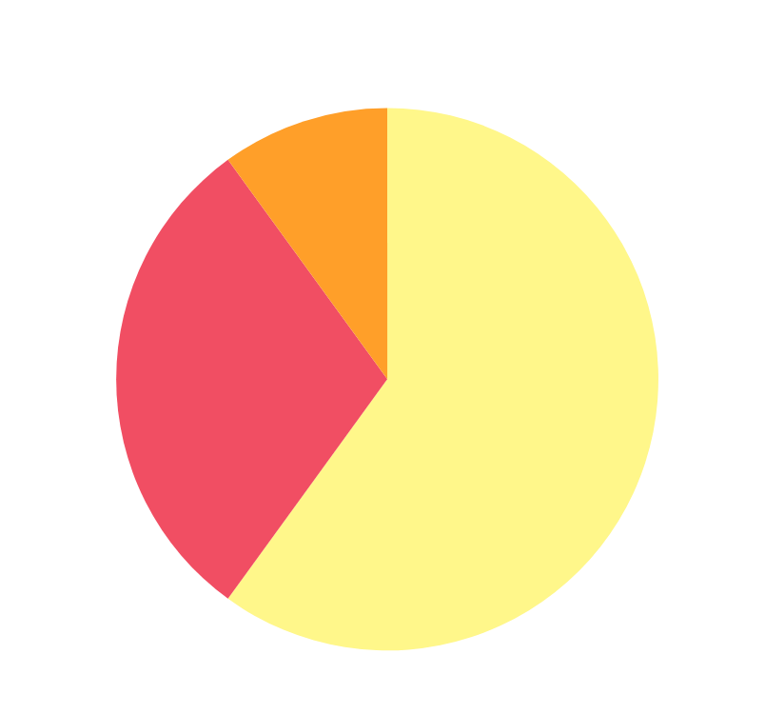
USE OF FUNDS
To initiate the use of our product, we would not need any funding since we are using SaaS model(Software as a Service). Our plan for using funds generated from investors is straightforward. We'll allocate 60% towards further developing our products, ensuring they stay competitive and meet customer needs. 30% will go into marketing and sales efforts to attract new customers and drive revenue growth. Finally, 10% will be set aside for strategic initiatives like market expansion and partnerships to fuel long-term growth.
A. 40% Product Development
B. 30% Marketing and Sales
C. 10 % Legal Compliance and other costs

Slide 10
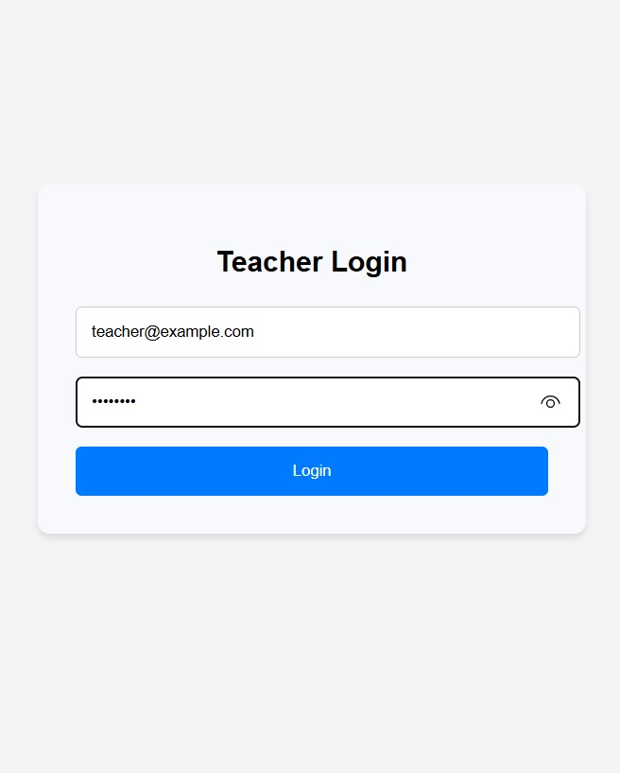
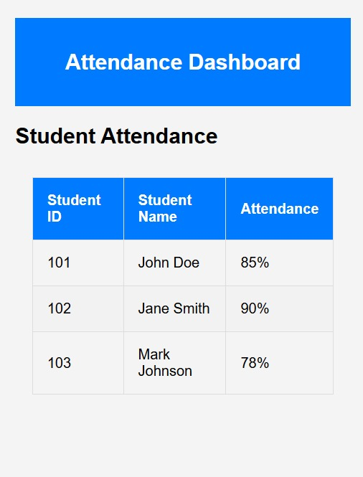
App Development
Some Clips from the App are shown below
We have completed our Frontend Development with the help of React

Slide 11
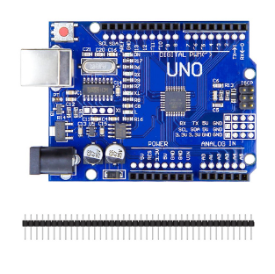
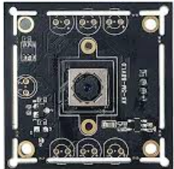
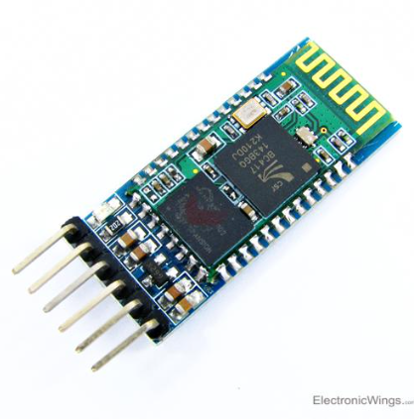
IOT and System Setup
Arduino Microcontroller: The Arduino serves as the central controller for the IoT setup. It will manage the data flow between the camera and other components, handling image capture and transmission for facial recognition.
Camera Module: A camera module (e.g., connected to Arduino or Raspberry Pi) will be used to capture images of students as they enter the classroom. The images are then sent to the computer vision model for processing.
The Bluetooth Module (e.g., HC-05) enables wireless communication between the IoT setup and the main server or cloud platform.

Slide 12
OUR TEAM
Ishan Kanodia
Saket Kumar Singh
Dev Bawari
Nishul Kumar Kadam
Dhruv Anil Rai
Vishal Kochar

Slide 13
Attenue
THANK YOU
for your time and attention
vishalkochar1718@gmail.com
saketkumarsingh@kgpian.iitkgp.ac.in
IIT Kharagpur

